Slide 1
TREC: APT Tactic / Technique Recognition via Few-Shot Provenance Subgraph Learning
Mingqi Lv¹,Hongzhe Gao¹,Xuebo Qiu¹,Tieming Chen¹,Tiantian Zhu¹,Jinyin Chen¹,Shouling Ji²
1.College of Computer Science and Technology, Zhejiang University of Technology
2.College of Computer Science andTechnology, Zhejiang University
CCS '24: Proceedings of the 2024 on ACM SIGSAC Conference on Computer and Communications Security
Notes:
1.浙江工業大學
2.浙江大學 講這個 https://www.kellect.org/#/kellect-4-aptdataset p19偷他的映射表
下周三、dataset問題、講Iforest

Slide 2
Outline
Abstract
Introduction
Rule based discussion
The scarcity of training samples
The difficulty of fine-grained sample labeling
The confusion of sample segmentation
Preliminary
Definitions
Threat Model
DataCollection
Methodology
NOI Detection and Subgraph Sampling
Technique Subgraph Representation
APT Technique Recognition
EXPERIMENT
Discussion and Limitation
CONCLUSION AND FUTURE WORK

Slide 3
Abstract
APT (Advanced Persistent Threat) with the characteristics of persistence, stealth, and diversity is one of the greatest threats against cyber-infrastructure.
understanding the tactics / techniques (e.g., Kill-Chain, ATT&CK) applied to organize and accomplish the APT attack campaign is also important for security operations.
Existing studies try to manually design a set of rules to map low-level system events to high-level APT tactics / techniques. But coarse-grained and lack generalization ability.
Notes:
現有的作品有使用provenace graph在同一個主機捕捉複雜的entity之間的關係(relation)。
了解攻擊event的ttp對於資安作為相當重要
現有的研究試著使用規則based的方法把low-level的系統event映射到high-level的APT tactic/technique，但是顆粒太粗且缺少generalization(泛化)能力

Slide 4
Abstract
TREC, the first attempt to recognize APT tactics / techniques from provenance graphs by exploiting deep learning techniques.
To address the “needle in a haystack” problem, TREC segments small and compact subgraphs covering individual APT technique instances from a large provenance graph based on a malicious node detection model and a subgraph sampling algorithm
To address the “training sample scarcity” problem, TREC trains the APT tactic / technique recognition model in a few-shot learning manner by adopting a Siamese neural network.
Notes:
透過惡意節點偵測模型與子圖採樣演算法，將龐大的溯源圖（Provenance Graph）分割成涵蓋單一 APT 技術實例的小型、緊湊子圖 。
採用孿生神經網路（Siamese Neural Network），以少樣本學習（Few-Shot Learning）的方式來訓練 APT 戰術與技術的辨識模型 。

Slide 5
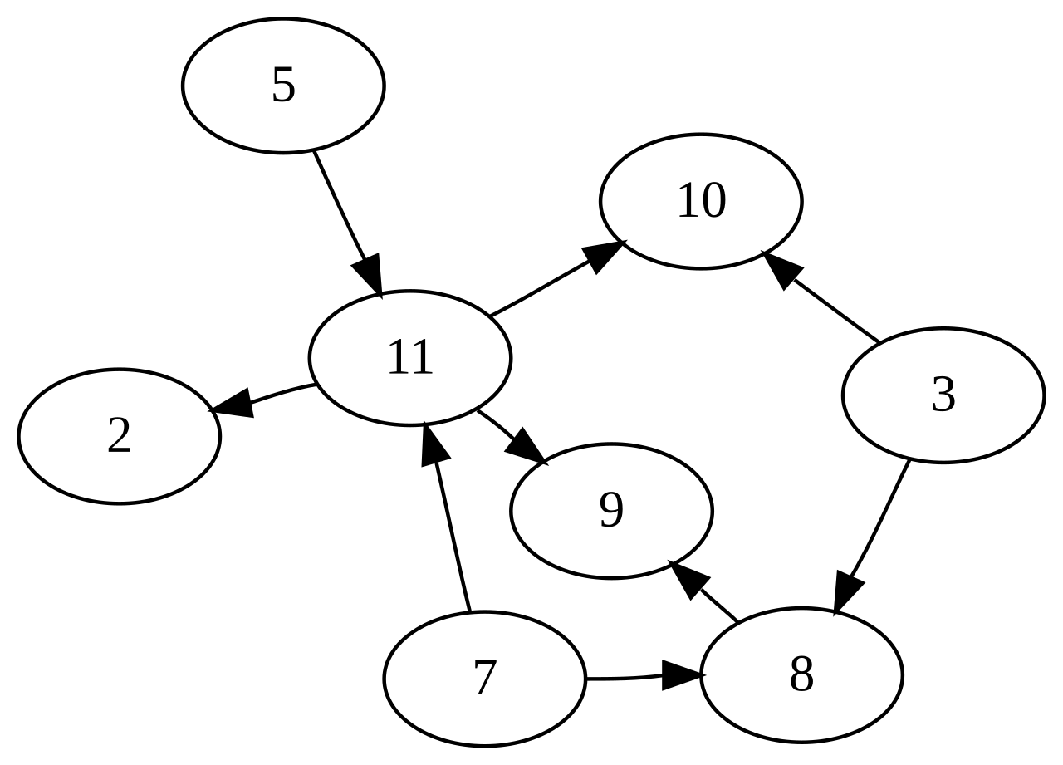
Introduction
To effectively detect the complex APT attacks, the detection systems should capture the long-term casual and contextual information of the fine-grained behaviors of the hosts.
Therefore, recent studies utilize provenance data collected from low-level kernel audit logs for APT detection [18, 39]. The provenance data can be represented as an acyclic graph (called a provenance graph).
nodes stand for system entities (e.g., processes, files, sockets) edges stand for system events (e.g., fork, write, open)
[18] Zhenyuan Li, Qi Alfred Chen, Runqing Yang, Yan Chen, and Wei Ruan. 2021. Threat detection and investigation with system-level provenance graphs: a survey.
[39] Michael Zipperle, Florian Gottwalt, Elizabeth Chang, and Tharam Dillon. 2022. Provenance-based intrusion detection systems: A survey. Comput. Surveys 55, 7 (2022), 1–36.
Notes:
為了更有效率的偵測APT attack，detection system必須捕捉主機們的fine-grained behaviors的長期因果和上下文資訊。
fine-grained behaviors就是log必須要細緻錄到完整細節資訊。比如說不同主機OS不一樣，錄製的軟體不一樣，細緻度也會不一樣。
acyclic graph(有向無環圖)
18:將檢測系統架構分為「資料收集（Data collection）」、「資料管理（Data management）」與「威脅檢測（Threat detection）」 。
39:將 PIDS(溯源圖入侵檢測系統) 的研究領域劃分為：資料收集、圖形摘要（Graph Summarization）、入侵檢測、基準資料集（Benchmark Datasets） 。
18&39: 兩篇論文的核心共識是：溯源圖是下一代網路防禦的極佳工具，能有效降低誤報並對抗複雜攻擊 。但目前實務上仍面臨三大挑戰：如何降低資料收集的系統開銷、如何有效壓縮龐大的圖形資料，以及如何建立標準的基準資料集來推進技術發展 。

Slide 6
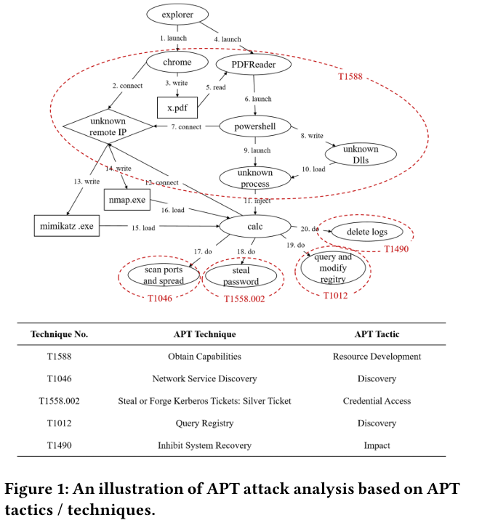
Introduction
Due to the persistence of APT attacks, the provenance graphs can be extremely large and complex. Even a single host can generate tens of millions of system events per day [37].
existing studies try to map the system events in raw provenance graphs to APT tactics / techniques based on attack knowledge such as Kill Chain and ATT&CK.
[37] TiantianZhu,JiayuWang,LinqiRuan,ChunlinXiong,JinkaiYu,YaoshengLi,Yan Chen, Mingqi Lv, and Tieming Chen. 2021. General, efficient, and real-time data compaction strategy for apt forensic analysis. (IEEE Transactions on Information Forensics and Security)
Notes:
因為APT超級隱藏和持久所以要找到APT的話就像是稻草堆找針，所以許多作品把event行為投射到Kill chain和Mitre的定義去抓出APT Chain。圖一例子:
37:這篇論文提出了一種名為 GS 和 SS 的數據壓縮策略，旨在解決進階持續性威脅（APT）取證分析中，系統日誌量過大導致的存儲與計算成本問題 。 全局語義維持壓縮 (Global Semantics, GS):在src entity（如進程）語義未改變的前提下，刪除指向同一目標實體的冗餘信息流 。
可疑語義壓縮 (Suspicious Semantics, SS):基於「取證分析大多僅關注攻擊相關事件」的假設，根據上下文刪除與攻擊無關的正常行為 。 GS 策略：壓縮比達 4.36x 至 13.18x 。
SS 策略：在 GS 基礎上進一步壓縮，總壓縮比達 7.86x 至 26.99x 。
圖一:
初始感染與植入 (T1588)
行為：受害者透過 Chrome 瀏覽器連接到未知的遠端 IP，並下載了包含惡意程式碼的 PDF 檔案 。
觸發與注入：開啟 PDF 後，內建的巨集（macro）被執行並喚醒 PowerShell 行程 。接著，PowerShell 產生一個未知行程，將惡意程式碼注入到正常的計算機程式（calc）中，藉此取得能力並隱藏蹤跡 。
內部探測與橫向移動 (T1046)
行為：被感染的 calc 行程開始掃描網路連接埠（scan ports），並嘗試散佈惡意腳本 。
憑證竊取 (T1558.002)
行為：利用著名的密碼竊取工具 Mimikatz 來盜取系統密碼 。(註：論文正文文字誤植為 T1588.002 ，但對照論文 Figure 1 表格，正確的 ATT&CK 編號應為 T1558.002 )。
系統資訊收集 (T1012)
行為：查詢並修改系統的登錄檔（Registry），用以探測系統配置或建立持久性 。
破壞與干擾復原 (T1490)
行為：最後，惡意程式會刪除備份檔案或日誌，以阻止系統復原並掩蓋攻擊痕跡 。

Slide 7
Introduction
The majority of existing work detects APT attacks based on binary classification [5, 29, 31]. Without pinpointing the detailed APT tactics / techniques, it would make cybersecurity analysts suffer from discovering true APT attacks among an enormous number of alerts [12].
Aiming at this problem, several existing studies try to recognize APT tactics / techniques in raw provenance graphs using rule based methods [13, 24, 31], where a predefined rule data base is applied to map each system event to a specific APT tactic / technique.
[5] APT-KGL: An Intelligent APT Detection System Based on Threat Knowledge and Heterogeneous Provenance Graph Learning.
[29] Threa trace:Detecting and tracing host based threats in node level through provenance graph learning.
[31] CONAN:A practical real time APT detection system with high accuracy and efficiency
[12] Nodoze: Combatting threat alert fatigue with automated provenance triage.
[13] {SLEUTH}:Real-time attack scenario reconstruction from {COTS} auditdata.
[24] Holmes: real-time apt detection through correlation of suspicious information flows.
Notes:
多數現有系統只能告訴你節點是「惡意的」還是「正常的」 。- [5 29 31]
也有其他作品嘗試用規則辨識APT tactics/technique
12:NODOZE該系統旨在透過上下文與歷史資訊，解決資安分析中常見的「警報疲勞（過多誤報）」問題。
13:Holmes是一個「以專家規則為核心，並輔以統計學習來減少誤報」的混合式偵測系統 。

Slide 8
Introduction - Rule based discussion
First, the human defined rules are arbitrary and can only represent the superficial patterns of APT tactics / techniques, which can be easily confused with specific benign activities.
Therefore, the rule based methods would usually cause a high degree of false alarms.
Second, the rules are often defined based on hard knowledge (e.g., whitelists, blacklists), which is difficult to generalize to new or mutant attacks.
On the other hand, learning based methods (i.e., machine learning and deep learning) are capable of discovering latent patterns from raw data in an automatic way.
Notes:
第一點，rule只能表達非常specific的APT tactics / techniques，非常容易被benign行為混淆。
而且，rule based容易造成高誤報
第二點，rules高度依賴黑白名單，無法適應變種行為
所以，透過學習方法可以從raw data自動化學習到特徵。

Slide 9
Introduction - The scarcity of training samples (C1)
APT attacks are extremely rare events, and thus it is almost impossible to collect a large number of real APT attack samples.
There are hundreds and thousands of APT techniques. For example, the current version of ATT&CK Matrix involves 227 APT techniques, some of which have more sub-techniques.
以上環境解釋了為甚麼他們要使用few-shot learning 去做學習。
Notes:
APT 攻擊極度罕見，實務上幾乎不可能收集到大量真實的攻擊樣本 。
更糟的是，ATT&CK 矩陣包含超過 227 種技術，這使得「單一特定技術」能取得的樣本量更加稀少，傳統模型根本無法有效訓練 。
意思就是說APT攻擊的sample就很少了，還要滿足227個technique根本天方夜譚。
就算有樣本也具有嚴重的長尾問題，所以few-shot是符合環境要求的。
針對 C1 (孿生神經網路)：採用少樣本學習模式，即便每種 APT 技術只有極少量樣本，依然能透過模型進行戰術與技術的精準辨識 。

Slide 10
Introduction - The difficulty of fine-grained sample labeling (C2)
APT attacks are stealthy, so the malicious activities of APT attacks are usually hidden in tens of thousands of system entities in a provenance graph.
In addition, the APT attacks often conceal their malicious activities in normal system entities (e.g., process injection,file contamination).
As a result, it is like looking for needles in a haystack to perform a binary benign / malicious labeling on all nodes in a provenance graph, let alone performing a multi-class APT tactic / technique labeling.
學習「正常系統行為模式」。只要揪出行為嚴重偏離常態的節點，就能鎖定潛在惡意節點（NOIs）。
Slot: Provenance-Driven APT Detection through Graph Reinforcement Learning - Google 簡報
Notes:
C2: 細粒度標註困難 (Difficulty of fine-grained labeling)：
APT經常藏在非常多的provenance graph的系統entities中
高階攻擊行為極度隱蔽，常透過（process injection）或檔案污染等方式，偽裝在成千上萬的正常系統實體中 。
要在溯源圖（Provenance graph）中對每個節點進行二元（惡意/良性）標註已經是大海撈針，更別提還要標註出多類別的具體戰術與技術 。
針對 C2 (無監督異常偵測)：系統完全不依賴人工標註，而是反向操作，讓模型學習「正常系統行為模式」。只要揪出行為嚴重偏離常態的節點，就能鎖定潛在惡意節點（NOIs） 。

Slide 11
Introduction - The confusion of sample segmentation(C3)
the malicious operations and the associated system entities of an APT technique instance can be mixed up with massive other benign system entities and system events.
and thus it is extremely difficult to determine the boundary of the subgraphs representing the APT technique instances.
說明了為甚麼要使用:subgraph sampling algorithm (子圖採樣演算法)
Notes:
一個完整的 APT 技術實例通常包含多個惡意操作，但這些操作會與海量的正常系統事件混雜交織在一起 。
這導致我們極難在圖結構中劃定單一攻擊技術的「準確邊界」，無法俐落地切出乾淨的子圖 。
可以提到SLOT的RL切圖法。
針對 C3 (子圖採樣演算法)：利用演算法找出具有關聯性的 NOIs，將它們從龐大的背景雜訊中剝離並連成獨立的子圖，明確劃分出個別 APT 技術的覆蓋範圍 。

Slide 12

Preliminary - Definitions 2.1
Definition 2.1. (Provenance Graph): A provenance graph is defined as 𝑃𝐺 = (𝑉,𝐸),where the node set 𝑉 represents all system entities and the edge set 𝐸 represents all system events. Each edge 𝑒 = (𝑢,𝑣,𝑝) denotes that system entity 𝑢 (called subject) performs operation 𝑝 on system entity 𝑣 (called object).
𝑢
𝑝
𝑣
𝑒 = (𝑢,𝑣,𝑝)
大𝑉是node集合 大E是edge集合
𝑃𝐺 = (𝑉,𝐸)

Slide 13
Preliminary - Definitions 2.2
Definition 2.2. (Technique Subgraph): A technique subgraph 𝑇𝑆𝐺 is a subgraph segmented from a provenance graph.
It contains system events belonging to the same APT technique instance. Note that it is usually impossible to construct perfect technique subgraphs in practice. In this paper, we try to find system entities that are strongly correlated with each other to form compact subgraphs as potential technique subgraphs.
Notes:
技術子圖(technique subgraph)是從龐大的原始溯源圖中分割（segmented）出來的一部分 。它包含了屬於「同一個 APT 技術實例」的所有系統事件 。

Slide 14
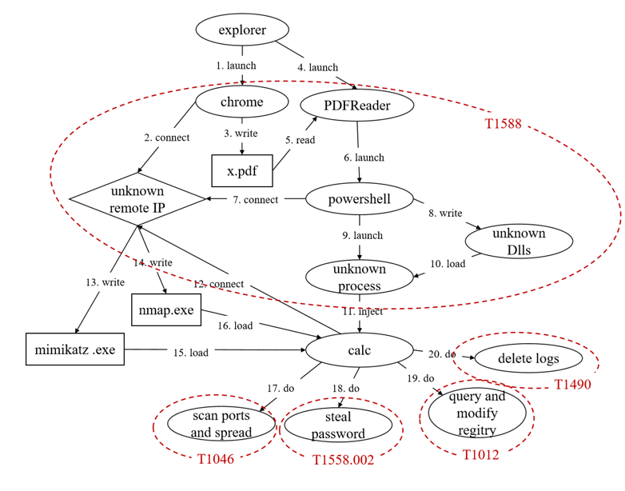
Preliminary - Definitions 2.2 - example
is a technique subgraph covering an instance of the APT technique “Obtain Capabilities”.
not raw provenance graph nodes, but the abstract of a subgraph for presentation convenience.
Notes:
例如在系統中，Chrome 行程對 PDF 檔執行了 write 操作，這個局部的子圖就被歸類在 T1588（取得能力）這個 APT 技術中 。
下面的TTP節點是為了方便表達於是用行為特徵說明了該子圖的行為。
一個橢圓就是切出來的成果，所以都是可以展開來看的。
他怎麼切後面會詳細說明。

Slide 15
Preliminary - Definitions 2.3
Definition 2.3. (NOI): A NOI (Node of Interest) is a system entity that performs malicious activity in an APT attack campaign.
Note that due to the propagation effect of malicious labels (i.e., the malicious labels would be propagated to all the nodes that are connected to the nodes that are initially labeled as malicious, resulting in too many malicious nodes) [4], it might be ambiguous whether a node is a NOI.
In this paper, we detect NOIs as nodes whose behaviors have great difference with normal nodes.
[4] Mining data provenance to detect advanced persistent threats
Notes:
NOI 是node - IOC是一個整體行為
定義：NOI 指的是在 APT 攻擊活動中，執行了惡意行為的系統實體 。
4:用windows的process monitor錄log，用spade建provenance graph。 把所有惡意節點以後的子節點標記成惡意，被惡意寫入的benign process被標記成汙染(tainted)。但是標籤並不是0或1，而是根據離惡意節點距離決定的惡意機率。 所以說在標記完的label本身就多了一個惡意機率的特徵。
本篇的做法是用類似anamoly detecion 的方式區分正常和惡意nodes。

Slide 16
Preliminary - Threat Model
Our threat model is similar to the previous work on provenance based APT detection [9, 12, 17].
First, we assume the integrity of the operation system and audit modules, and thus the provenance data are considered credible.
Second, we assume that the attackers can use any tactics and techniques to conduct APT attacks, but their malicious behaviors are captured by the audit modules.
In addition, we also assume that APT techniques have distinct patterns, which can be captured by statistical or semantic features [17].
[9] Unicorn: Runtime Provenance-Based Detector for Advanced Persistent Threats.
[12] Nodoze: Combatting threat alert fatigue with automated provenance triage.
[17] NODLINK: An Online System for Fine Grained APT Attack Detection and Investigation.
Notes:
我們的做法跟我們的三位老朋友很像。
1.作者假設作業系統與底層的稽核模組（Audit modules）是完整且未被駭客破壞的，因此收集到的溯源資料（Provenance data）被視為絕對可信 。
2.作者假設攻擊者可以使用任何高階的戰術與技術來進行 APT 攻擊，但無論他們怎麼變換手法，其惡意行為最終都會被稽核模組捕捉並記錄下來。
3.作者假設APT的technique具有不同的特徵並且可以被統計或語意等特徵捕捉

Slide 17
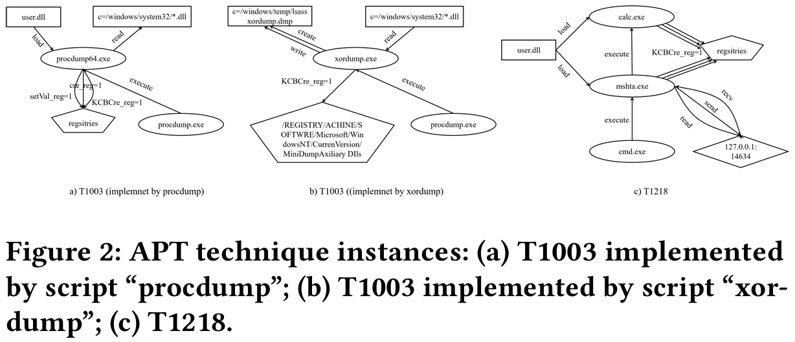
Preliminary - Threat Model
T1003:OS Credential Dumping
T1218:System Binary Proxy Execution
In addition, we also assume that APT techniques have distinct patterns, which can be captured by statistical or semantic features [17].
Notes:
3.作者假設APT的technique具有不同的特徵並且可以被統計或語意等特徵捕捉
T1218:Adversaries may bypass process and/or signature-based defenses by proxying(代理server) execution of malicious content with signed, or otherwise trusted, binaries.
Proxy Execution 是指攻擊者利用作業系統內建的、合法的、且通常帶有受信任數位簽章的執行檔，來「代為執行」惡意的程式碼、腳本或 Payload。
127.0.0.1是loopback address 所以只會執行在本機裡面

Slide 18


Preliminary - Data Collection
To collect large-scale provenance data to cover the APT techniques in ATT&CK,we used Atomic Red Team,an automatic security test tool provided by Red Canary.
and collected provenance dataset by using KELLECT, an efficient kernel level provenance data collection tool developed by our research team.
a Kernel-based Efficient and LossLess Event log CollecTor
Atomic Red Team提供具有TTP根源的APT technique
KELLECT是浙江大學和其他資安學院及組織製作的log錄製工具
Notes:
作者沒有使用現成的公開資料集，而是透過專業工具自行模擬並收集。

Slide 19
Preliminary - KELLECT
由 C++ 開發，主打「核心級 (Kernel-based)」、「高效能」與「無損 (Lossless)」。對記憶體的運用和錄製原理相較於微軟做了一些升級...
Kellect4APT 資料集：根據 MITRE ATT&CK 框架錄製並開源了第一個針對特定技術行為的基準數據集，包含 178 種攻擊行為 。
關係映射表：建立 18 個關聯映射表（例如將執行緒 ID 映射回Process名稱），在解析過程中即時補全缺失的屬性（如補全 FileRead 事件中的文件名）。
Notes:
可以偷他的映射表 由於這個 ID 是無效的，分析人員無法直接從這條日誌判斷是哪個進程（Process）發起的網路請求，這給了 APT 攻擊者掩蓋行為的機會 。

Slide 20
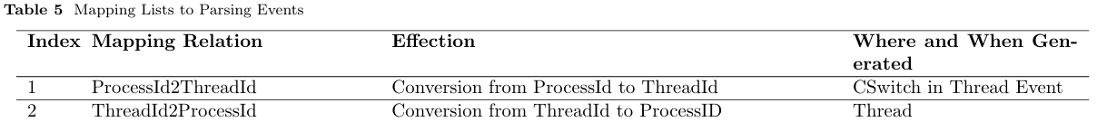
Preliminary - KELLECT
關係映射表：建立 18 個關聯映射表（例如將執行緒 ID 映射回Process名稱），在解析過程中即時補全缺失的屬性（如補全 FileRead 事件中的文件名）。
當系統產生原生 TCP/IP 事件（如 TcpIpSend）時，ETW 紀錄中的執行緒 ID（Thread ID）通常會顯示為預設值 0xffffffff 。
每當CPU切換執行任務時，Kellect 就會紀錄下當前Process ID 與執行緒 ID 的對應關係並存入映射表 。
結果會被補全為「Process A (某惡意腳本) 透過執行緒 B 發起了網路連線」。
Notes:
由於這個 ID 是無效的，分析人員無法直接從這條日誌判斷是哪個進程（Process）發起的網路請求，這給了 APT 攻擊者掩蓋行為的機會 。

Slide 21
Preliminary - KELLECT
關係映射表：維護 18 個關聯映射表（例如將執行緒 ID 映射回Process名稱），在解析過程中即時補全缺失的屬性（如補全 FileRead 事件中的文件名）。
在 FileRead 事件中通常缺少文件名，Kellect 會利用 FileObject2Name 映射表（編號 3），將核心內的指針轉換回人類可讀的檔案路徑 。
將核心格式路徑 \device\harddrive... 轉換為使用者熟悉的 C:\...（編號 9），使日誌能直接用於後續的威脅狩獵（Threat Hunting）。
Notes:
由於這個 ID 是無效的，分析人員無法直接從這條日誌判斷是哪個進程（Process）發起的網路請求，這給了 APT 攻擊者掩蓋行為的機會 。

Slide 22
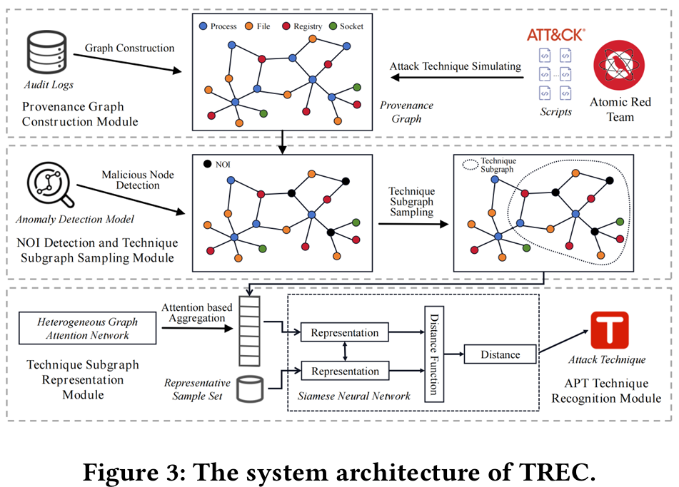
Preliminary - System Architecture
The provenance graph construction module
持續收集底層的系統核心事件，並將這些事件編排建構成一張完整的Provenance Graph
The NOI detection and sub-graph sampling module
套用異常偵測模型，在無監督的情況下，找出圖中潛在的惡意節點然後套用「子圖採樣演算法 (Subgraph sampling algorithm)」
The technique subgraph representation module
運用「異質圖嵌入技術 (Heterogeneous graph embedding)」，將剛切出來的技術子圖（TSG）編碼轉換成一段特徵向量 。
The APT technique recognition module
判斷該技術子圖屬於哪一種 APT 技術 。
1.
2.
3.
4.
Notes:
Audit log裡面有Atomic red team的APT attack
用anamoly detection把惡意節點圈出來
用TSG大法(Subgraph sampling algorithm)切分子圖
用APT辨識大法判斷TSG是甚麼APT

Slide 24
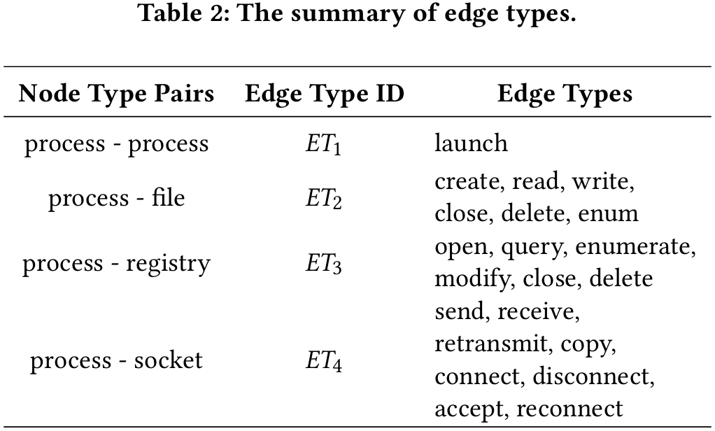
Methodology - NOI Detection and Subgraph Sampling
The purpose of NOI detection is to quickly discover potential malicious nodes in the provenance graph.
Feature initialization First, we categorize the nodes in a provenance graph into four types , and the interactions between different types of nodes can form 21 types of edges.
Then, for each node 𝑣ᵢ in the provenance graph, we cre ate a 42-dimensional vector 𝑒𝑖 = [𝑎1,𝑎2, ...,𝑎21,𝑎22,𝑎23, ...,𝑎42] as the initial features of 𝑣ᵢ
𝑒𝑖 = [𝑎1,𝑎2, ...,𝑎21,𝑎22,𝑎23, ...,𝑎42]
21edges
incoming edges
outgoing edges
Notes:
用他的定義方式 前 21 維：記錄該節點「接收」到各類邊緣的數量（Incoming edges） 。
後 21 維：記錄該節點「發出」到各類邊緣的數量（Outgoing edges） 。
𝑒𝑖用兩個one-hot encoding計數的方式作為代表。

Slide 25

Methodology - NOI Detection and Subgraph Sampling
Feature learning we use node types as the supervised signals, and train the GNN with a downstream task of node type classification (i.e.,classifying a node into process, file, registry, or socket). E(𝑡) is node feature matrix 𝐺 is the topology of the provenance graph W(𝑡−1) is a trainable parameter matrix then input E(𝑡) into a softmax classifier to make node type classification.
我們可以得知作者用GNN去疊代node的資訊量，t越大資訊越多。
但是不清楚t的大小跟hop是否絕對相關，只能說是正相關。
Notes:
用這個 用GNN去疊代node的資訊量，t越多資訊越多。
用GNN架構去學這個node的最終矩陣，然後把Et拿去做分類學習(node type classification.). ->每個節點輸出四個機率值（對應 Process, File, Registry, Socket）。
經過 1 層 GNN ($t=1$)：節點 D 的特徵向量融合了 C (File) 和 E (Registry) 的資訊。
經過 2 層 GNN ($t=2$)：節點 D 透過節點 C，進一步「看見」了節點 B (powershell.exe)。
經過 T 層 GNN：節點 D 的特徵矩陣 E(T 不再只是一個普通的行程特徵。它現在包含了一整串故事：「這是一個由外部網路連線觸發 PowerShell 下載後，進而執行並寫入開機機碼的行程」。
權重更新：GNN 透過公式中的 $W^{(t-1)}$ 聚合周圍鄰居的資訊來猜測。如果它猜成「Socket」，模型就會產生誤差（Loss），進而修正參數；如果猜成「File」，模型就學到了正確的系統運作邏輯。
這一頁舉例怎麼辦

Slide 26
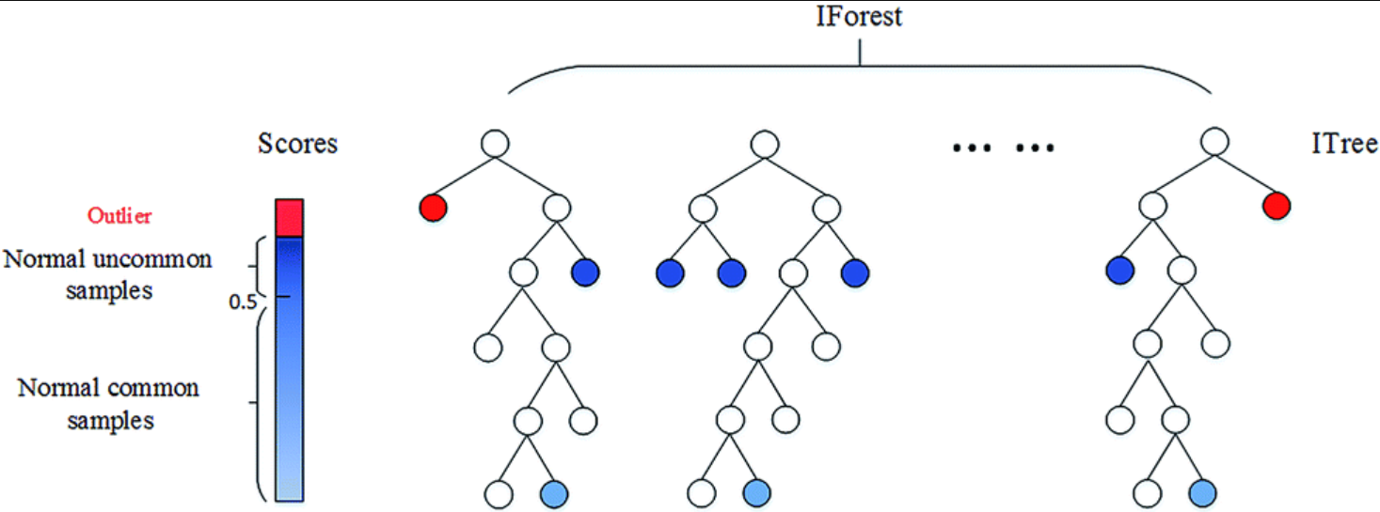
Methodology - NOI Detection and Subgraph Sampling
NOI detection Specifically, we apply iForest [20], which has been proven to be an effective outlier mining algorithm, to detect outliers in all “process” nodes in the provenance graph. These outliers are treated as NOIs.
[20] Isolation forest.
Stata：异常值检测算法-分离森林-iforest
Notes:
在獲得每個節點包含 T 上下文資訊的最終特徵向量 E(T)後，系統不再區分「它是什麼類型」，而是觀察「誰的行為最怪」 。

Slide 27
Methodology - NOI Detection and Subgraph Sampling
Seed node selecting In network science, a hub node is a node that has a significant higher degree of connectivity in the graph.[29] For example, a malicious node related to the APT technique “Exfiltration over C2 Channel” usually has a large number of “connect” and “send” edges to remote IP nodes. Thus, we select the NOI with the highest degree of connectivity as the seed node.
[29] Threa trace:Detecting and tracing host based threats in node level through provenance graph learning.
Notes:
基於29說的很多連線的node很大機率是壞node，所以他們把seed node以這個現象當基準。 C2 頻道外傳技術（Exfiltration over C2 Channel）：惡意節點通常會對遠端 IP 產生大量的 connect（連線）與 send（傳送）邊緣 。
就地取材技術（Living off the Land）：例如被濫用的 powershell 節點，為了執行敏感指令，會產生大量的 launch（啟動）邊緣 。

Slide 28
Methodology - NOI Detection and Subgraph Sampling
Graph searching Starting from a seed node 𝑣ₖ, we firstly perform a DFS (Depth-First Search), going forward or backward, to find out whether we can reach other NOIs in 𝜆 hops, where 𝜆 is a pre-defined length threshold of search paths. If no NOI could be found in a 𝜆-hop search path, we stop expanding the search along this path. Otherwise, we recursively start the DFSs from each found NOI to expand the search paths.
seed node是指連接率很高的node，通常能包含惡意節點但不是一定
Notes:
搜尋策略：從選定的種子節點 vk 開始，執行深度優先搜尋 (DFS) 。
雙向探索：搜尋不限於單一方向，而是可以向前（順著事件流）或向後（溯源原因）進行探索 。
路徑門檻：系統引入了一個𝜆長度閾值 （預定義的 hop 數），作為搜尋的終止條件 。
seed node是指連接率很高的node，通常能包含惡意節點但不是一定
如果𝜆找不到NOI就停
否則用其他找到的NOI去擴展路徑

Slide 29
Methodology - NOI Detection and Subgraph Sampling
Subgraph sampling When the graph searching process from seed node 𝑣𝑘 stops, a technique subgraph 𝑇𝑆𝐺𝑘 = (𝑆𝑉𝑘,𝑆𝐸𝑘) will be created where 𝑆𝑉𝑘 is the node set containing all the visited nodes during the graph searching process (including both NOIs and benign nodes) and 𝑆𝐸𝑘 is the corresponding edge set.
Notes:
節點集合 SV_k：包含搜尋過程中所有被訪問過的節點。這裡有一個關鍵點：它同時包含 NOI（潛在惡意節點）與良性節點（Benign nodes） 。邊緣集合 SE_k：對應於這些節點之間的所有系統事件連線 。

Slide 30
Technique Subgraph Representation
To classify the technique subgraphs into different APT tactics / techniques, they have to be embedded into feature vectors by aggregating the feature vectors of all the involved nodes.
First, the technique subgraphs involve multiple types of nodes and edges, which should be taken into account when learning the representations.
Second, due to the diversity of APT techniques, the technique subgraphs could have great difference in the sizes.
Third, each technique subgraph contains a large portion of benign nodes, and thus different nodes in a technique subgraph should have great differences in the impact on the final representation.
Notes:
為了把子圖分類不同的APT tatic/techniques，必須用所有涉及的node特徵向量把子圖變成特徵向量。
但是，
異質性 (Heterogeneity)：子圖包含多種類型的節點（Process, File, etc.）與邊緣（Read, Write, etc.），必須同時考慮這些不同類型的語意 。
尺寸差異巨大 (Size Diversity)：不同 APT 技術產生的圖規模差異極大。在作者的資料集中，最大的子圖有 20,841 個節點，最小的僅有 436 個，模型必須能處理這種變動性 。
良性雜訊過高 (Noise Interference)：每個技術子圖中仍包含大量良性節點導致最終的特徵向量會壞掉，這些節點對最終特徵的貢獻度應遠低於惡意節點。

Slide 31
Technique Subgraph Representation
we design a technique subgraph embedding model by extending HAN (Heterogeneous Graph Attention Network) [30].
Formally, the purpose of technique subgraph embedding is to learn a function that map seach technique subgraph 𝑇𝑆𝐺 = (𝑆𝑉,𝑆𝐸) to a 𝑑-dimensional feature vector h_𝑇𝑆𝐺(𝑑 ≪ |𝑆𝑉|), where 𝑆𝑉 and 𝑆𝐸 are node set and edge set.
The feature vector h_𝑇𝑆𝐺 should be capable of preserving the key semantics in 𝑇𝑆𝐺.
[30] Heterogeneous Graph Attention Network.
Notes:
作者透過擴展 HAN (Heterogeneous Graph Attention Network) 演算法來學習一個函數，將技術子圖 TSG = (SV, SE) 映射到一個低維度的 d 維特徵向量 h_TSG
SV是node set，SE是edge set。
特徵向量h_TSG應該要包含TSG的關鍵語意。 要補充30是甚麼，怎麼映射的。後面有。

Slide 32
Technique Subgraph Representation
The feature vector h_𝑇𝑆𝐺 should be capable of preserving the key semantics in 𝑇𝑆𝐺.
First, since provenance graphs are heterogeneous, we apply meta-path scheme [7] to help the model to learn node/edge type aware graph traversal paths.
Second, we use attention mechanism to force the technique subgraph representations to focus on more important parts of the subgraph.To this end, we perform technique subgraph embedding through two steps, i.e., meta-path defining and heterogeneous technique subgraph embedding.
[7] metapath2vec: Scalable representation learning for heterogeneous networks
Notes:
元路徑方案 (Meta-path Scheme)：利用定義好的路徑規則，協助模型學習「節點與邊緣類型感知」的圖走訪路徑 。
注意力機制 (Attention Mechanism)：強迫模型將注意力集中在子圖中「更重要」的部分（即與攻擊行為高度相關的節點），而非被良性節點淹沒 。
步驟一：定義元路徑 (Meta-path Defining)：
原理：元路徑是一串預定義的節點與邊緣序列（例如：Process -> File -> Process），用來捕捉隱藏在異質圖中的特定語意關聯 。
步驟二：異質技術子圖嵌入 (Heterogeneous Technique Subgraph Embedding)：
原理：利用注意力機制，從不同維度（節點、路徑、全圖）對子圖資訊進行權重分配與聚合 。

Slide 33
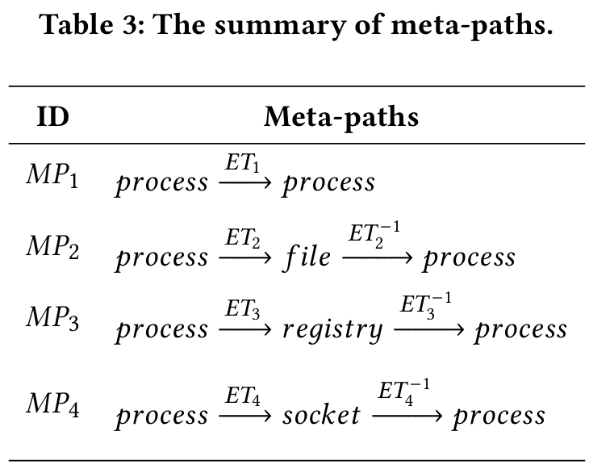
Technique Subgraph Representation - Meta-path defining
Meta-path defining
A meta-path is defined as a sequence of node / edge types in the form of
Heterogeneous technique subgraph embedding
The hierarchical attention mechanism used for the heterogeneous technique subgraph embedding includes a node-level attention, a path-level attention, and a graph-level attention.
node-level attention
在給定的一條 MP 之下，評估鄰居節點對中心節點 vᵢ 的重要性 。
path-level attention
要決定哪一條MP對節點 vᵢ 來說最重要 。
graph-level attention
將子圖內所有節點的特徵向量，濃縮成能代表整張技術子圖TSG的最終特徵向量 h。
Notes:
ET就是用 table 2 的edge定義

Slide 34

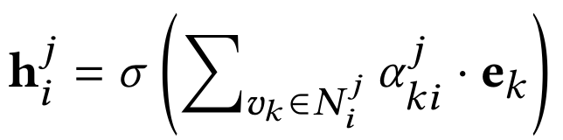
Technique Subgraph Representation - Heterogeneous technique subgraph embedding
node-level attention
Specifically, given the node 𝑣𝑖 and a meta-path 𝑀𝑃ⱼ, we travel 𝑀𝑃ⱼ starting from 𝑣𝑖 to form a set of nodes (denoted as 𝑁ʲᵢ ), which connect with 𝑣ᵢ via 𝑀𝑃ⱼ (including 𝑣ᵢ itself).
Then, we apply self-attention to learn the attention weight of each node 𝑣𝑘 in 𝑁ʲᵢ on 𝑣ᵢ (denoted as 𝛼ʲₖᵢ ), where 𝑒ₖ and 𝑒ᵢ are the initial feature vectors of nodes 𝑣𝑘 and 𝑣ᵢ .
Finally, the feature vector of 𝑣ᵢ (𝑒ᵢ ) is updated by aggregating the feature vectors of all nodes in 𝑁ʲᵢ with the corresponding attention weights.
Notes:
目標：在給定的一條 MP 之下，評估鄰居節點對中心節點 vᵢ 的重要性 。 圈出範圍：把node v 用MPj去遍歷vi連到其他node做為集合Nji，ek和ei就是前面提到的大小為42的矩陣。
計算權重：利用自我注意力機制（Self-attention），vk就是Nji裡面所有的node，全部拿去算self-attention然後softmax算出 αjki。
特徵集合：利用所有鄰居的α把資訊聚合起來，經過activation function後，得到節點 vi 在這條元路徑下的更新特徵 hji。

Slide 35
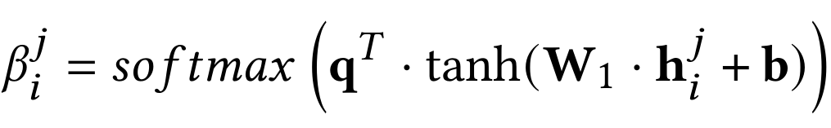

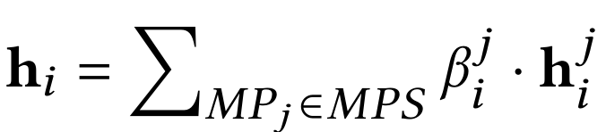
Technique Subgraph Representation - Heterogeneous technique subgraph embedding
edge-level attention
for each node 𝑣ᵢ in the technique subgraph, after obtaining the updated feature vectors of 𝑣ᵢ for all meta-paths (denoted as ),we try to measure the importance of each meta-path for 𝑣ᵢ.
given the node 𝑣ᵢ and a meta-path 𝑀𝑃ⱼ, we compute the attention weight of 𝑀𝑃ⱼ on 𝑣ᵢ (denoted as 𝛽ʲᵢ ), where W₁ is a trainable parameter matrix, q and b are trainable parameter vectors.
we can fuse the meta-path aware feature vectors to obtain the final feature vector of 𝑣ᵢ (denoted as hᵢ)
Notes:
目標：要決定哪一條MP對節點 vᵢ 來說最重要 。
收集所有視角的結果：經過上一步，節點 vi已經拿到了所有元路徑的特徵集合 hij。
計算路徑權重：將這些特徵乘上可訓練的參數矩陣 W1，計算出每條元路徑 $MPj 對節點 vi 的注意力權重 𝛽ʲᵢ。
最終特徵融合：根據路徑權重 𝛽ʲᵢ，將不同元路徑的特徵融合在一起，得到節點 vi 最終的特徵向量 hi 。

Slide 36
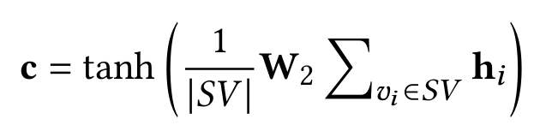

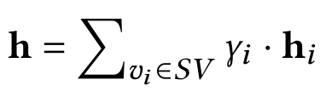
Technique Subgraph Representation - Heterogeneous technique subgraph embedding
graph-level attention
we try to generate one embedding for the technique subgraph TSG based on the final feature vectors of all nodes in SV.
we firstly compute a global context vector c by simply averaging the node feature vectors followed by a nonlinear transformation. where W₂ is a trainable parameter matrix.
Then, we compute the attention weight for each node 𝑣ᵢ (denoted as 𝛾ᵢ) that is aware of the global context vector c.
Finally, we compute the technique subgraph embedding (denoted as h) as the weighted sum of node feature vectors
Notes:
萃取「全域上下文向量 (Global context vector, c)：系統會先將所有節點的特徵做一個初步的簡單平均，然後乘上一個可訓練的參數矩陣 W₂ 進行非線性轉換 。你可以把它想像成模型先粗略地「看一眼」這張圖的整體輪廓。
計算「節點專屬注意力權重 𝛾ᵢ」：接著，將剛剛算出來的全域向量 c，與每一個節點 vi 的特徵向量進行「內積（Inner product）」運算 。
產出「最終圖向量 (h)」：最後，根據算出來的權重 𝛾ᵢ，將所有節點的特徵進行加權總和（Weighted sum），產出最終代表這張子圖的特徵向量h。

Slide 37
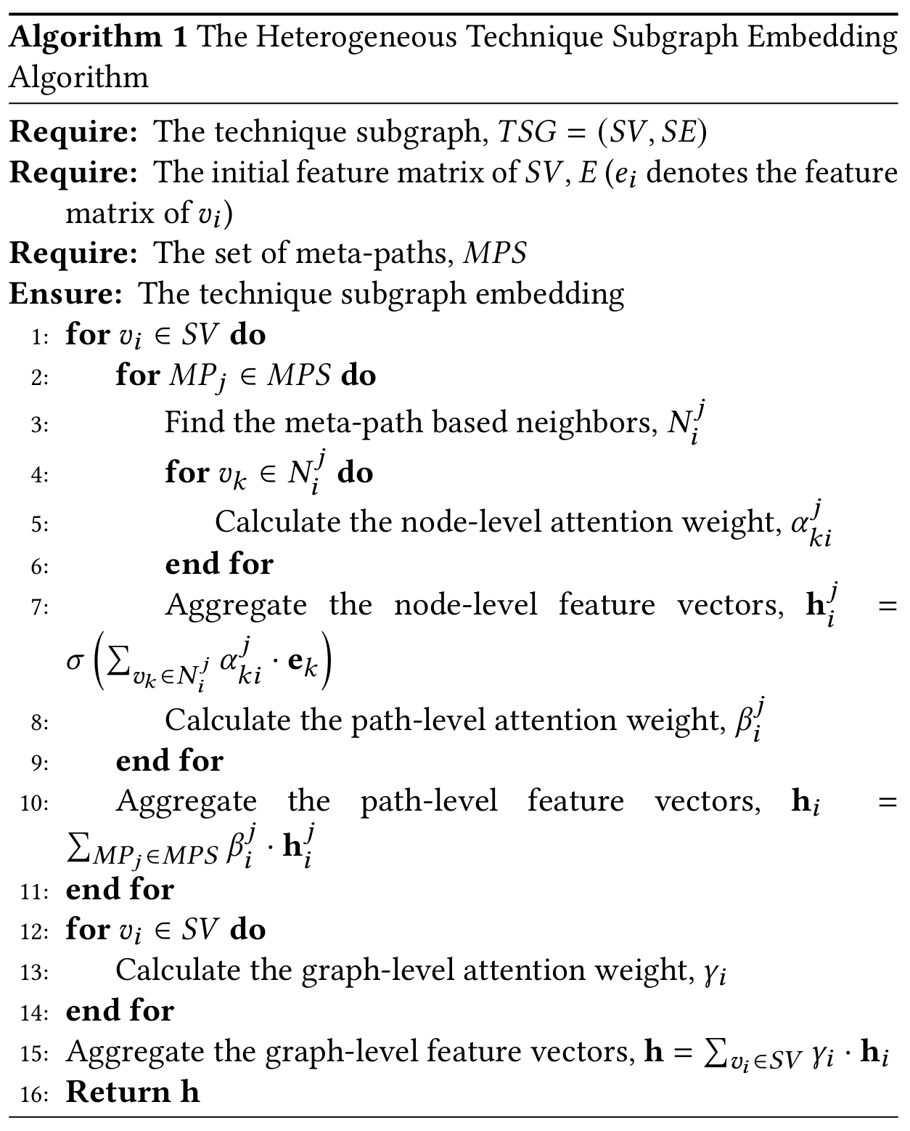
Overall process of the proposed heterogeneous technique
subgraph embedding

Slide 38
APT Technique Recognition
First, it is almost impossible to train a multi-class classification model with high generalization ability to effectively capture and distinguish the diverse patterns of different APT techniques.
Second, the APT techniques are constantly evolving. When we need to consider a new APT technique, the entire classification model has to be retrained to adapt to the new label space.
Aiming at these problems, we adopt a Siamese neural network based few-shot learning method to build the APT technique recognition model.
Notes:
樣本極度稀缺：現實中無法為每種 APT 技術收集到足夠的訓練樣本，這導致傳統分類模型無法有效捕捉各種技術的特徵，極容易失去泛化能力 。
無法靈活應對新型攻擊：APT 技術不斷在演進 。傳統分類模型的「輸出標籤數量」是固定的，如果今天駭客發明了一種全新的攻擊技術，整個分類模型就必須重新訓練以適應新的標籤空間 。
於是他們使用 Siamese neural network(孿生神經網路) based few-shot learning method

Slide 39
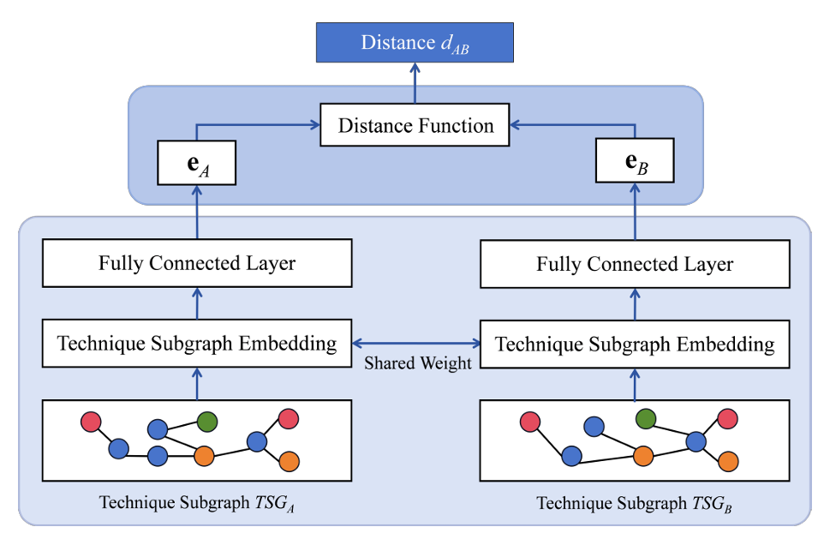
APT Technique Recognition - Model Architecture
Input Layer First, each branch of the input layer accepts a technique subgraph (i.e., 𝑇𝑆𝐺𝐴) representing an individual APT technique instance as input.
Encoding Layer transform the technique subgraph into a feature vector (i.e., h𝐴), and then stacks a fully connected layer to further process the feature vector to obtain a final embedding (i.e., e𝐴)
Interactive Layer the interactive layer uses distance function (e.g.,Euclidean distance, cosine similarity, etc.) to calculate the distance between the final embeddings of the two branches (i.e., 𝑑𝐴𝐵).
Notes:
輸入層 (Input Layer)：雙分支結構運作邏輯：與傳統分類器一次只吃一張圖不同，孿生網路的輸入層有「兩個分支（Branches）」。
輸入資料：每次訓練或推論時，它會同時接收「一對」技術子圖（例如 $TSG_A$ 與 $TSG_B$）。這兩張圖可能是同類型的 APT 技術，也可能是不同類型的。
編碼層 (Encoding Layer)：特徵轉換與壓縮運作邏輯：這是系統的「大腦」，兩個分支同樣具備這套編碼層（且參數是完全共享的，這正是孿生的意義）。
兩階段處理：圖嵌入 (Graph Embedding)：首先套用前面（3.2節）辛苦建構好的「異質圖注意力模型 (HAN)」，將龐大的子圖 $TSG_A$ 壓縮成一個向量 $h_A$。
特徵映射 (Fully Connected Layer)：接著，再串接一個全連接層（FC Layer），對向量 $h_A$ 進行最後的非線性轉換，得出最適合用來算距離的終極特徵向量 $e_A$。
互動層 (Interactive Layer)：決斷相似度運作邏輯：它將兩個分支產出的終極向量 $e_A$ 與 $e_B$ 匯集在一起。距離計算：使用距離函數（Distance function，如歐幾里得距離或餘弦相似度）來計算這兩個向量在多維空間中的距離 d_AB。

Slide 40
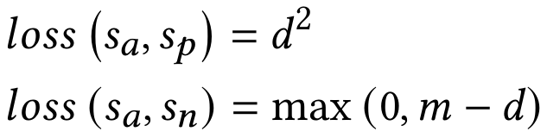
APT Technique Recognition - Model Training
for each available technique subgraph sample, we treat it as an anchor sample (denoted as 𝑠ₐ), and randomly select a positive sample from the same APT technique (denoted as 𝑠ₚ) and a negative sample from a different APT technique (denoted as 𝑠ₙ).
Then, we could split the triplet into two sample pairs 𝑥1 = (𝑠𝑎,𝑠𝑝) and 𝑥2 = (𝑠𝑎,𝑠𝑛), and adopt them to train the Siamese neural network with the aim to minimize the contrastive loss function
where 𝑑 is the distance between two input samples and 𝑚 is the margin.
Notes:
錨點樣本 sa, Anchor：當下挑選出來作為基準的 APT 技術子圖。
正樣本 sp, Positive：與錨點屬於「同一種」APT 技術的另一個樣本。
負樣本 sn, Negative：與錨點屬於「不同種」APT 技術的樣本。
拉近同類：讓 sa 和 sp在高維特徵空間中的距離 d 盡可能小。推開異類：讓 sa 和 sn 在特徵空間中的距離盡可能大。
設定 Margin 是為了模型比較能收斂與穩定。如果不設定 m，模型會把所有的運算資源浪費在把『已經分得很開的負樣本』推得更遠。引入 m 後，模型只要確保異類樣本之間的距離達到 m 就會停止懲罰（Loss 為 0），進而將算力集中在那些『難以分辨、靠得很近的邊緣樣本（Hard Negatives）』上。

Slide 41
APT Technique Recognition - Model Inference
for each APT technique 𝐶𝑖, we pick a representative sample for 𝐶𝑖 (i.e.,𝑠𝑖).
we input 𝑠𝑘 and 𝑠𝑖 into the two branches of the trained Siamese neural network to obtain two final embeddings (i.e., 𝑒𝑘 and 𝑒𝑖).
we calculate the distance between 𝑒𝑘 and 𝑒𝑖 (denoted as 𝑑)
we could classify 𝑠𝑘 to the APT technique with the smallest distance. We could also set a lower-bound distance threshold to discover outlier samples that are not belong to any known APT technique.
Notes:
特徵轉換：將新樣本 $s_k$ 與圖鑑上的標準樣本 si分別丟入孿生神經網路的兩個分支，得出各自的終極特徵向量 ek 與 ei。
計算距離：算出這兩個向量在多維空間中的距離 dₖᵢ。
最小距離分類：系統會把圖鑑裡所有的標準答案都拿出來跟 sk 算一次距離。最後，誰的距離最小（長得最像），這個新樣本就被歸類為哪一種 APT 技術。

Slide 42
EXPERIMENT - Experiment Setup
Dataset
The existing public provenance datasets are not suitable for the evaluation of APT tactic / technique recognition methods due to the following reasons. (StreamSpot是圖層級、ATLAS, DARPA TC 只有anamoly的label)
所以他們用18頁的方式自己錄製並蒐集dataset。
The dataset contains 473 provenance graph samples, which involve 26 APT techniques and 45 APT sub-techniques from 9 APT tactics.
Each APT technique / sub-technique has an average of only 18 / 10 samples, so it is a typical few-shot learning problem.
The average number of nodes and NOIs of the provenance graph samples are 8957 and 4, respectively.
Notes:
使用他的dataset 標籤顆粒度太粗：現有的公開資料集（如 StreamSpot, DARPA TC）通常只給「二元標籤（Binary labels）」。也就是說，它們只會告訴你「這個節點/這張圖是惡意的還是正常的」，卻不會告訴你「這是哪一種 APT 技術」。這完全無法用來訓練分類器。
極端的不平衡挑戰 (Needle in a Haystack)：作者透過 Atomic Red Team 自己建構了資料集。你可以特別向教授強調這個驚人的數據：每張圖平均有 8,957 個節點，但惡意節點 (NOI) 平均只有 4 個！ 這種極端的雜訊比例，完美還原了真實世界的資安困境。
殘酷的少樣本現實 (Few-shot Reality)：資料集涵蓋了 26 種技術，但平均每種技術只有 18 個樣本（子技術甚至只有 10 個）。這句話直接坐實了前面使用「孿生神經網路」的合理性——在這麼少的樣本下，傳統分類器絕對會崩潰（Overfitting），只有少樣本學習（Few-shot learning）能存活。
Label 在 atomic就能找到。

Slide 43
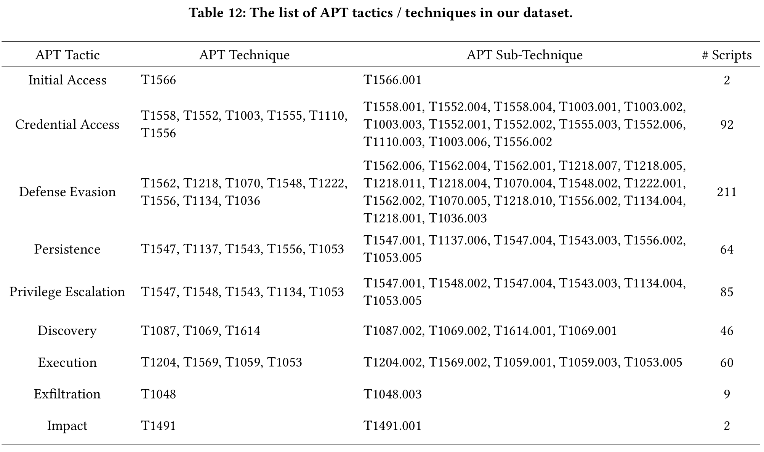
EXPERIMENT - Experiment Setup
Dataset
26 APT techniques and 45 APT sub-techniques from 9 APT tactics.
Each APT technique / sub-technique has an average of only 18 / 10 samples, so it is a typical few-shot learning problem.
The average number of nodes and NOIs of the provenance graph samples are 8957 and 4, respectively.
Notes:
標籤顆粒度太粗：現有的公開資料集（如 StreamSpot, DARPA TC）通常只給「二元標籤（Binary labels）」。也就是說，它們只會告訴你「這個節點/這張圖是惡意的還是正常的」，卻不會告訴你「這是哪一種 APT 技術」。這完全無法用來訓練分類器。
極端的不平衡挑戰 (Needle in a Haystack)：每張圖平均有 8,957 個節點，但惡意節點 (NOI) 平均只有 4 個！ 這種極端的雜訊比例，完美還原了真實世界的資安困境。
殘酷的少樣本現實 (Few-shot Reality)：資料集涵蓋了 26 種技術，但平均每種技術只有 18 個樣本（子技術甚至只有 10 個）。這句話直接坐實了前面使用「孿生神經網路」的合理性——在這麼少的樣本下，傳統分類器絕對會崩潰（Overfitting），只有少樣本學習（Few-shot learning）能存活。

Slide 44
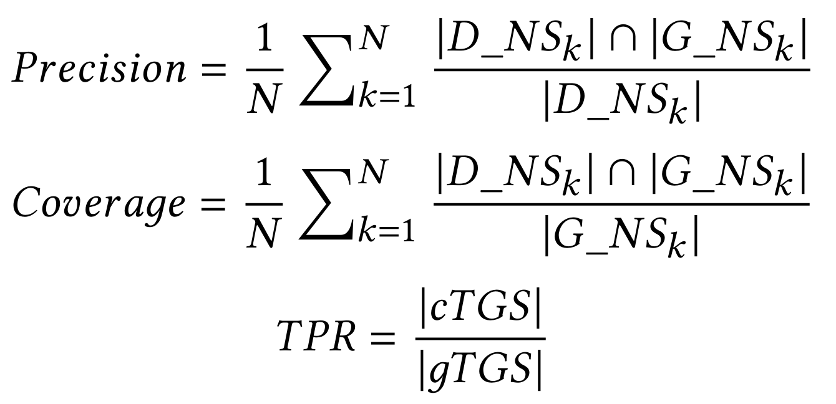
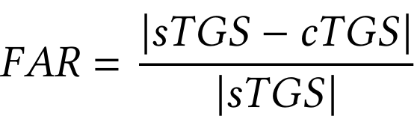
EXPERIMENT - Evaluation strategies
NOI Detection Task
we apply a Leave-Malicious-Out evaluation strategy, i.e., the NOI detection model is trained on a dataset with all benign nodes, and tested on a dataset with malicious nodes and the same number of randomly sampled benign nodes.
indicators : Accuracy,Precision, Recall, F1 Score, FAR (False Alarm Rate), and AUC (Area Under Curve)
Technique Subgraph Sampling Task
we evaluate its performance by comparing the sampled technique subgraphs and ground-truth technique subgraphs based on several customized evaluation metrics
APT Tactic / Technique Recognition Task
True_Graph ：直接把完美無雜訊(人工標記)的攻擊子圖餵給 AI。
Sampled_Graph ：把 TREC 前面模組自己採樣（含有部分正常雜訊）的子圖餵給模型。
Raw_Graph ：什麼都不切，直接把整張 8,957 個節點的超大原始圖餵給 模型。
indicators : TacACC、TechACC、SubACC
Notes:
A. NOI 偵測任務 (NOI Detection Task)
評估重點：測試無監督模型抓壞人的能力。
策略 (Leave-Malicious-Out)：這是一個非常嚴格的測試法。訓練時「完全不給看」惡意節點（只用純正常的背景雜訊訓練）；測試時才把惡意節點混進去。
指標：精準度 (Precision)、召回率 (Recall)、F1 Score，以及教授最在乎的 FAR (誤報率)。P,R,F1是為了惡意節點而計算的指標，FAR是為了誤報率。
B. 子圖採樣任務 (Technique Subgraph Sampling Task)
評估重點：測試演算法切出來的圖，跟真實的攻擊範圍有多像。
策略：將系統自動採樣出來的子圖，與人工標記的「標準答案 (Ground-truth)」進行重疊度比對。 可疑節點集合 D_NSk 中，到底有多少個是 真的惡意節點 G_NSk 在所有標準答案的攻擊子圖集合 gTGS中，我們成功產出了多少張「正確（達標）的子圖」 真正及格的子圖 cTGS
C. APT 戰術/技術辨識任務 (APT Tactic / Technique Recognition Task)
這是整篇論文的最高潮（也是消融實驗 Ablation Study 的精華）。作者設定了三個對照組來測試神經網路的辨識能力：
True_Graph (標準答案組)：直接把完美無雜訊的攻擊子圖餵給 AI。這用來測量 AI **「純粹的辨識天花板」**有多高。
Sampled_Graph (實戰驗證組)：把 TREC 前面模組自己採樣出來（含有部分正常雜訊）的子圖餵給 AI。這代表了系統**「End-to-End 的綜合實戰能力」**。
Raw_Graph (原始暴力組)：什麼都不切，直接把整張 8,957 個節點的超大原始圖餵給 AI。
TacACC (戰術準確率, Tactic)：最寬鬆的指標。模型只要能看出攻擊者的「大方向目的」就算對（例如：知道這是在做「Initial Access 初期入侵」還是「Lateral Movement 橫向移動」）。 TechACC (技術準確率, Technique)：中等難度。模型需要精準指出具體的攻擊手段（例如：知道這是透過「Phishing 釣魚」進來的）。 SubACC (子技術準確率, Sub-technique)：最嚴苛的指標。模型必須看透最底層的細節（例如：精確指出這是「Spearphishing Attachment 夾帶惡意附件的魚叉式釣魚」）。 2.公式

Slide 45
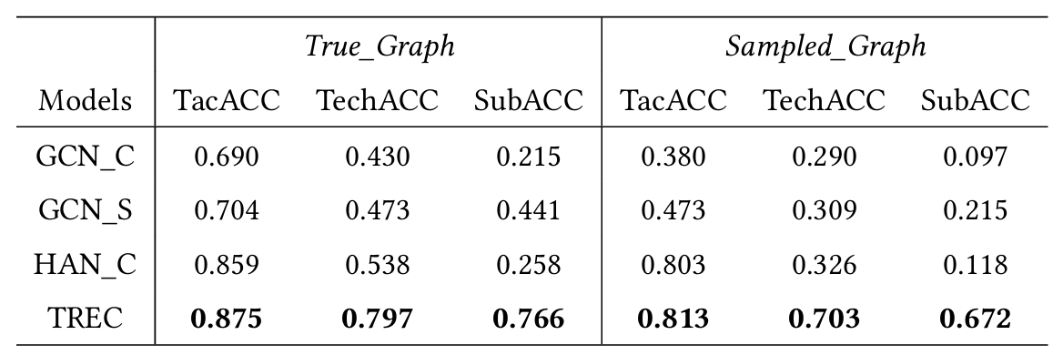
Experiment 1: Comparison Experiment
GCN_C:拔掉了異質圖屬性（無視 Process, File, Socket 的差異，全部當成一樣的節點）、拔掉了注意力機制（直接用簡單平均 Pooling，讓良性雜訊徹底稀釋惡意節點）、拔掉了孿生網路（改用傳統分類器）。
GCN_S:依然拔掉了異質圖屬性與注意力機制，但保留了孿生神經網路 (Siamese neural network )。
HAN_C:保留了為了 Meta-path 設計的的異質圖神經網路 HAN，以及能過濾雜訊的注意力機制，但拔掉了孿生網路(Siamese neural network)，使用傳統的分類器。
Notes:
TacACC最高因為他最寬鬆
True_Graph比較好是因為他用無雜訊的圖
TREC 勝過 GCN_S；HAN_C 勝過 GCN_C。代表異質圖很重要。
TREC 勝過 HAN_C；GCN_S 勝過 GCN_C。代表孿生神經網路 (Siamese neural network )很有用。

Slide 46
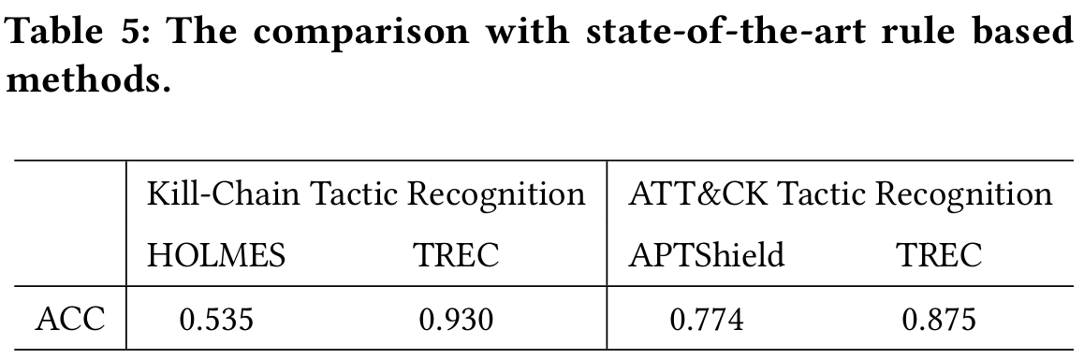
Experiment 1: Comparison Experiment
作者為了證明 AI 驅動的 TREC，比Rule-based的系統還要實用且強大。採用了HOLMES的Kill-chain tactic 和 APTShield Tactic Recognition做比較。
HOLMES
APTShield
Notes:
我們要用這個 HOLMES (基於 Kill-Chain)：
核心運作：它仰賴資安專家撰寫大量的「TTP 規則」，將底層雜亂的 Audit logs 先向上映射成「中介敏感活動（例如：執行了 Shell、讀取了敏感檔案）」。接著，再透過分析這些敏感活動之間的關聯，來拼湊出攻擊者目前處於 Kill-Chain 的哪一個戰術階段（分 7 類）。
APTShield (基於 ATT&CK)：
核心運作：它給各種可疑的系統實體與事件貼上「可疑標籤 (Suspicious labels)」。接著，依靠專家設計的「轉移規則 (Transfer rules)」，沿著資料流與控制流，把這些標籤一路傳遞、聚合起來。當標籤累積到一定程度，系統就能認出這屬於 ATT&CK 框架中的哪一種戰術（分 10 類）。
兩者都應用在他們自己做的dataset上

Slide 47
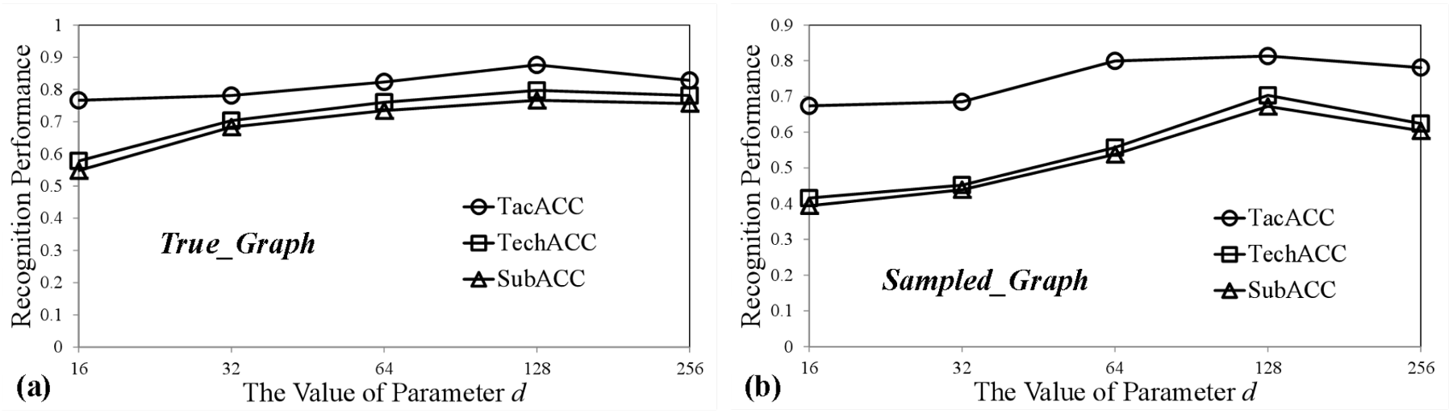
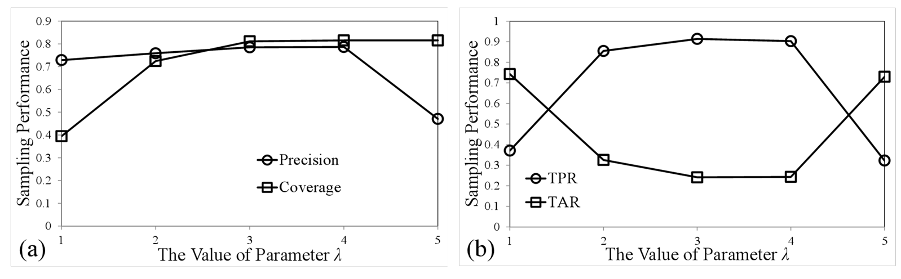
Experiment 2: Parameter Tuning Experiment
把一張包含數百個節點的技術子圖（TSG），壓縮成一個長度為 d 的一維數學向量。這個 d 到底該設多大？
維度在16~64時發現d越大越好
維度在128~256時發現出現微幅下降(Overfitting)
λ代表我們從一個惡意節點出發，最多可以往外走幾步尋找下一個惡意節點。
λ=1時覆蓋率極低、λ=5時準確率極低，於是他們選擇λ=3。
Notes:
核心問題：我們要把一張包含數百個節點的技術子圖（TSG），壓縮成一個長度為 d 的一維數學向量。這個 d 到底該設多大？
實驗範圍：作者將維度 $d$ 從 $16$ 逐步調高到 $256$，觀察模型在辨識 APT 戰術與技術時的準確率變化。
當維度太小（如 d=16 到 64 時）：資訊遺失 (Underfitting / Information Loss)
現象：準確率呈現明顯的上升趨勢（也就是一開始效能很差，越調大越好）。
解釋：如果 $d$ 太小，就像用過度失真的 JPEG 格式壓縮圖片。作業系統底層複雜的圖形拓樸（Topology）和高階的資安語意（Semantics）根本塞不進這麼短的向量中，導致模型「看攏無」，無法分辨不同的攻擊手法。
當維度太大（如 $d=128$ 增加到 $256$ 時）：過擬合與雜訊 (Overfitting / Noise)
現象：準確率的上升趨勢停止了，甚至出現微幅下降 (Slight decrease)。
解釋：這是一個極佳的防禦亮點！您可以解釋：「報告委員，維度並不是越大越好。當我們賦予模型過高的維度空間時，它會開始把子圖裡那些『不重要的正常系統行為（雜訊）』也一起死記硬背下來。在我們這種樣本數極少的 Few-shot 學習環境中，這會直接導致過擬合 (Overfitting)，反而拖累了最終的辨識效能。」
當 λ 太小（例如 λ=1）：見樹不見林
現象：覆蓋率（Coverage）極低，導致 TPR（真陽性率）慘不忍睹。
當 λ 太大（例如 λ=5）：雜訊大爆炸
現象：覆蓋率雖然到頂了，但精準度（Precision）出現了**「懸崖式的暴跌 (cliff-like decline)」**。

Slide 48
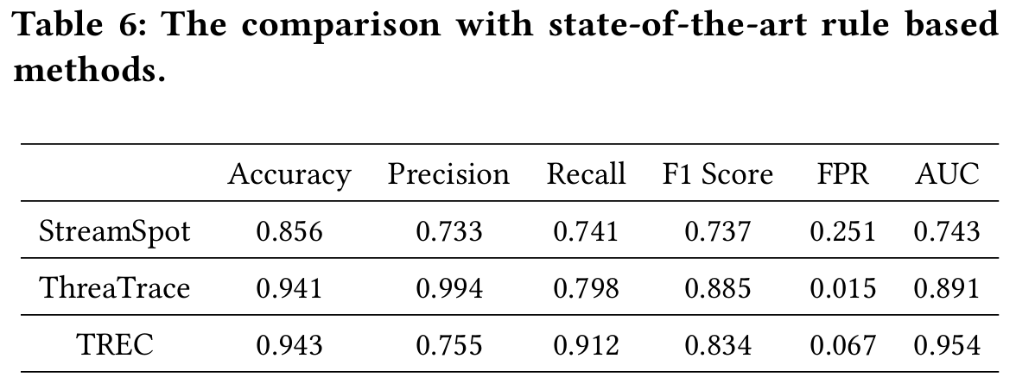
Experiment 3 : Ablation Experiment
作者將 NOI Detection 與：StreamSpot（無監督分群）與 ThreaTrace（預測型自我監督 GNN）。進行比較
在複雜的provenance graph中，依賴純粹的「無監督分群」是無效的，必須加入 GNN 的self-Supervised signals）才能精準抓出惡意特徵。
ThreaTrace 在Precision和FPR上稍微贏過了 TREC。
因為ThreaTrace 有多層分類器所有Precision和FPR會比較好
但是這一步只是TREC的輔助，所以重點在於Recall(為了涵蓋所有惡意節點)
Notes:
ThreaTrace 的作法：它疊加了多層分類器來死磕「降低誤報」（追求高 Precision），因為它的異常偵測結果就是最終的警報。
TREC 的作法：TREC 的異常偵測只是一個「輔助起點」，目的是為了找出嫌疑犯（種子節點），交給下一關的「子圖採樣（Subgraph sampling）」去畫出完整的犯罪地圖。

Slide 49
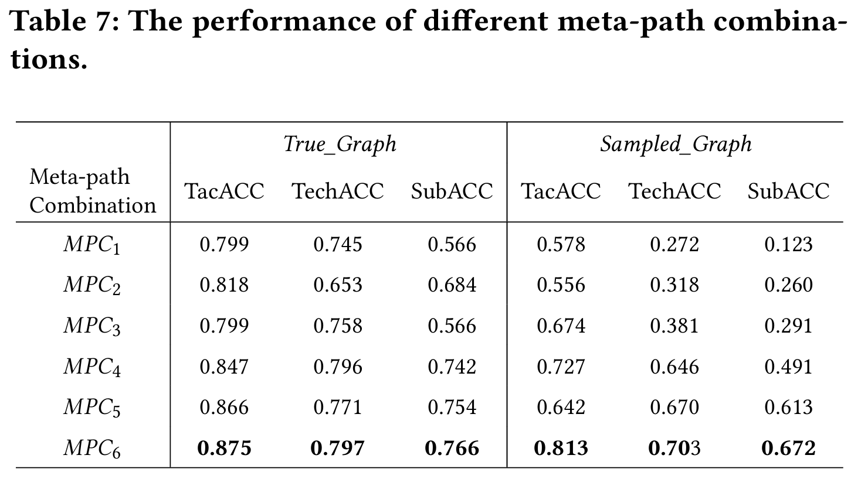
Experiment 3 : Ablation Experiment
作者設計了 MPC₁ 到 MPC₆ 共六組不同的元路徑組合（Meta-path combinations）。
MPC₁只考慮MP₁
MPC₂只考慮MP₁&MP₂
MPC₃只考慮MP₁&MP₂&MP₄
MPC₄只考慮MP₁&MP₂&MP₃
MPC₅只考慮MP₁&MP₃&MP₄
MPC₆只考慮MP₁&MP₂&MP₃&MP₄
Notes:
例如 $MPC_1$ 只看 Process 之間的關係。
MPC_3 結合了 Process, File 和 Socket（通常這包含了下載惡意軟體並執行的行為）。
MPC_6 則是火力全開，包含所有元路徑。
APT 攻擊從來不是單一維度的。如果模型只看行程與檔案如MPC_2，它可能抓得到勒索軟體，但絕對抓不到透過網路進行的 C&C 橫向移動。
這段消融實驗的設計，正是為了量化不同系統實體（File, Socket, Registry）在 APT 攻擊生命週期中所貢獻的語意價值。
最終的數據證明，唯有融合所有元路徑的 MPC6，才能在異質圖中捕捉到最完整的攻擊

Slide 50
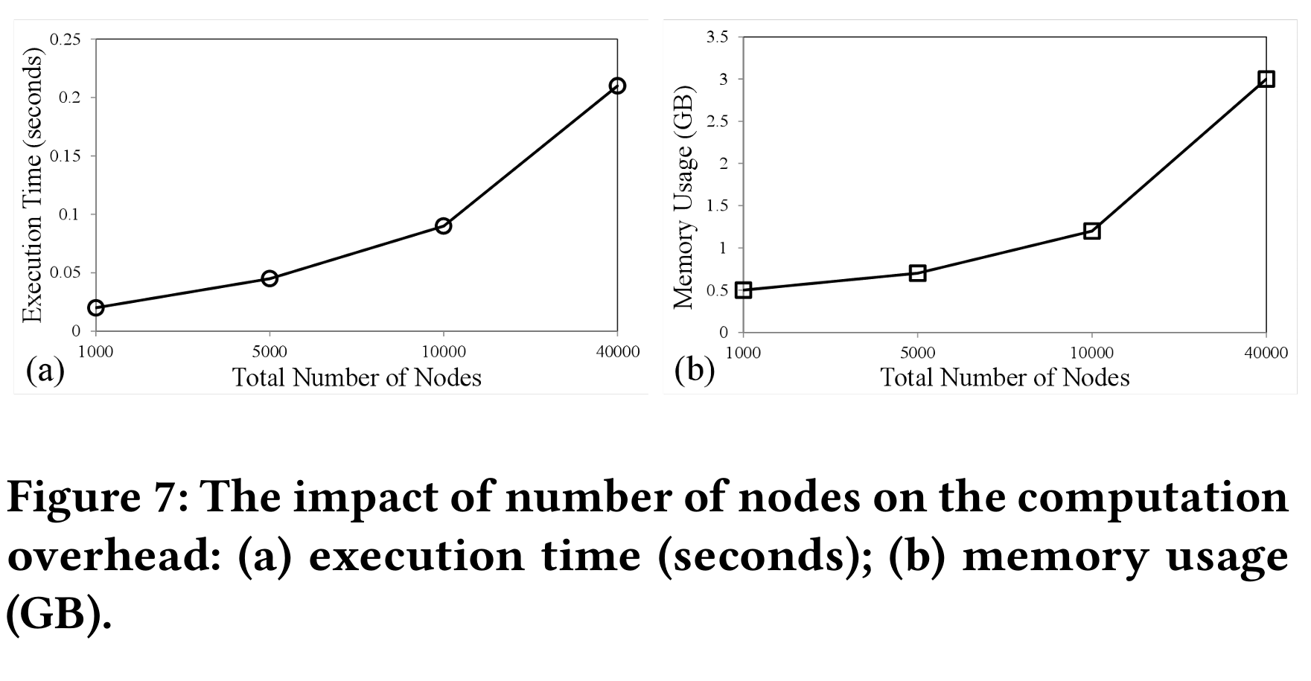
Experiment4 : Overhead Experiment
系統最耗時和記憶體的地方，在於特徵轉換（把圖變成向量）與孿生網路算距離的部分。
一張技術子圖TSG平均909個節點。
把這張未知的圖，拿去跟資料庫裡 26 種 APT 戰術範本比對一輪，只需約 0.5 秒。
拿去跟 45 種 APT sub technique範本比對一輪，只需約 0.9 秒。
Notes:
Node一多成本會指數型提高

Slide 51
Discussion and Limitation
The prospect of TREC
深度學習在 APT 偵測落地最大的問題就是「缺乏惡意樣本」。TREC 的初步成果證明了，只要架構設計得當（圖採樣 + 孿生網路），僅靠極少數樣本就能達到令人滿意的戰術與技術辨識率。
The application of TREC
輸入：接收底層系統吐出的、夾帶大量雜訊的惡意實體 (NOIs)。
處理：將這些零碎的警報壓縮並賦予高階的語意特徵。
輸出：產出乾淨的技術實例 (Technique instances)，再精準地交給後端溯源系統去串接成完整的攻擊鏈 (Campaign)。
The limitation of TREC
Significant larger label space：偵測只是二元分類，但辨識是龐大的多類別分類（TTPs），這直接導致原本就很少的訓練樣本被嚴重稀釋，所以找不太到適合的樣本
Subtle deviations：不同種的 APT 技術之間長得極度相似。攻擊者往往會使用系統內建的合法工具去隱藏攻擊行為。
Notes:
Significant larger label space (對辨識攻擊而言，labeling很難)
Subtle deviations(隱藏偏差，找不到攻擊)

Slide 52
CONCLUSION AND FUTURE WORK
TREC employs a novel combination of techniques in anomaly detection, graph sampling, graph embedding, and distance metric learning, to detect and recognize APT tactic / technique instances from raw provenance graphs with very limited training samples.
most APT attack knowledge is shared by documents (e.g., CTIs) or rules (e.g., blacklists, IoCs). Therefore, we will try to extract attack knowledge and integrate it with machine learning methods for more robust APT tactic/ technique recognition.
APT is a long-range attack campaign, and thus how to leverage the APT tactic / technique recognition model proposed in this paper to capture the big picture of the APT attack campaign will also be a promising research topic.
Notes:
技術力總結：TREC 成功將異常偵測、圖形採樣、圖嵌入與距離度量學習完美融合，證明了「機器學習能在極少數訓練樣本下，碾壓傳統的規則式專家系統」。 引入外部威脅情資 (CTI) 與專家知識：目前的模型只看系統 Log，但真實世界的駭客知識大多存在於文字報告（CTI）或 IoC 黑名單中。未來應該要把這些知識跟機器學習融合。 從「單一技術」走向「宏觀戰役 (Big Picture)」：TREC 目前只做到了認出「單一個別的 APT 技術」，但 APT 是一場長期的戰役。未來的挑戰是如何利用這些辨識出的技術，去拼湊出整個 APT 攻擊的宏觀全貌。

Slide 53
Kellect4APT Dataset
Kellect4APT uses the open-source collector Kellect for data collection.
Kellect is a real-time, non-invasive, efficient Windows kernel log collector that can provide rich kernel behavior data as the basis for user and application behavior.
The dataset involves 9 tactics with 43 sub-techniques and 304 sample files, totaling 18.5GB.

Slide 54
Data collection environment
Based on Windows 10, the CPU of the host is i5-10400F, the GPU is 1050ti, the memory is 16GB.
Data was collected with specified noise and scripts running.
Noise 1 | Video live streaming and common office software
Noise 2 | Gaming and file downloading

Slide 55
Collection content
Referring to the events provided by Windows, we collect and analyze a total of the following seven events, which are included as follows:
TCP/IP | TcpIpSendIPV4, TcpIpSendIPV6, TcpIpRetransmitIPV4, TcpIpRetransmitIPV6, TcpIpRecvIPV4, TcpIpRecvIPV6, TcpIpConnectIPV4, TcpIpReconnectIPV6, TcpIpConnectIPV6, TcpIpReconnectIPV4, TcpIpAcceptIPV4, TcpIpAcceptIPV6, TcpIpDisconnectIPV4, TcpIpDisconnectIPV6
FileIO | FileIOWrite, FileIORead, FileIOFileCreate, FileIORename, FileIOCreate, FileIOCleanup, FileIOFlush, FileIOClose, FileIODelete, FileIOFileDelete
Registry | RegistryCreate, RegistrySetValue, RegistryDeleteValue, RegistryOpen, RegistryDelete, RegistryFlush, RegistryClose, , RegistrySetInformation, RegistryQuery, RegistryQueryValue
Process | ProcessStart, ProcessEnd, ProcessDCStart, ProcessDCEnd | Image | ImageDCStart, ImageLoad
Thread | ThreadStart, ThreadEnd, ThreadDCStart, ThreadDCEnd | DiskIO | DiskIOWrite, DiskIORead

Slide 56
Collection content - Common properties
In this case, each event has two parts of attributes: public and private attributes. Each public is described as follows:
Event | corresponding event name
TID | ID of the thread that generated the event
PID | ID of the process that generated the event
PName | name of the process that generated the event
PPID | parent ID of the process that generated the event

Slide 57
Collection content - Common properties
In this case, each event has two parts of attributes: public and private attributes. Each public is described as follows:
PPName | parent name of the process that generated the event
TimeStamp | time of the event occurred
Host-UUID | the host ID that generated the event, distinguish the specific log source in the joint analysis of multi-host logs
Args | private property pairs for specific event types

Slide 58
Collection content - Private properties - file_create event
In this case, each event has two parts of attributes: public and private attributes. Each public is described as follows: This type properties is various depends on the BaseEvent types.
IrpPtr | IO request packet
TTID | Thread identifier of the thread that is creating the file
FileObject | Identifier that can be used for correlating operations to the same opened file object instance between file create and close events
CreateOptions | Values passed in the CreateOptions and CreateDispositions parameters to the NtCreateFile function
FileAttributes | Value passed in the FileAttributes parameter to the NtCreateFile function
ShareAccess | Value passed in the ShareAccess parameter to the NtCreateFile function
OpenPath | Path to the file

Slide 59
Collection content - Private properties - FileIo_Name event
In this case, each event has two parts of attributes: public and private attributes. Each public is described as follows: This type properties is various depends on the BaseEvent types.
FileObject | Match the value of this pointer to the FileObject pointer value in a DiskIo_TypeGroup1 event to determine the type of I/O operation
FileName | Full path to the file, not including the drive letter

